Slide 1
Web Controlled Boom Camera
Embedded Linux Project
Group ”3”

Slide 2
Group “3” Project: Camera Boom
Mitchell Wagner
Paul Boston
Jose Da Costa Filho
Charles Palsa
Shamiul Islam
Hardware/PWM/3D Prints
Hardware/PWM/Web Setup
Software/Gallery/Scripts
Software/Website/Stream
Software/Pictures on site

Slide 3
Goals
Create a multi directional rotating stand
Mount a camera on the stand
Create a website to display the feed
be able to save images
be able to control stand

Slide 4
Elements of Project:
Web Interface
Camera: Live + Pictures
Arm Stand/Motors

Slide 5
WebSite:
Live Stream
Take Pictures
View Pictures
Control Buttons (for camera)
Mobile

Slide 6
Website Implementation
BootStrap For Main Site
CSS For Main Site
HTML For Main Site
JavaScript GUI
Ajax To Post PHP
PHP To Run Python Scripts
Python To Run Camera and . motor functions

Slide 7
Camera:
Live Stream
Take Snap Shots
Refresh Feed

Slide 8
Camera Implementation
MJPEG Server
Saves a picture to a file location and serves one picture at a time

Slide 9
Stand/Motor:
Strong
3D printed
360 degrees Motion, any direction

Slide 10
Stand/Motor Implementation
360 Degree motors
stand holds camera
3D Designed parts in inventor

Slide 11
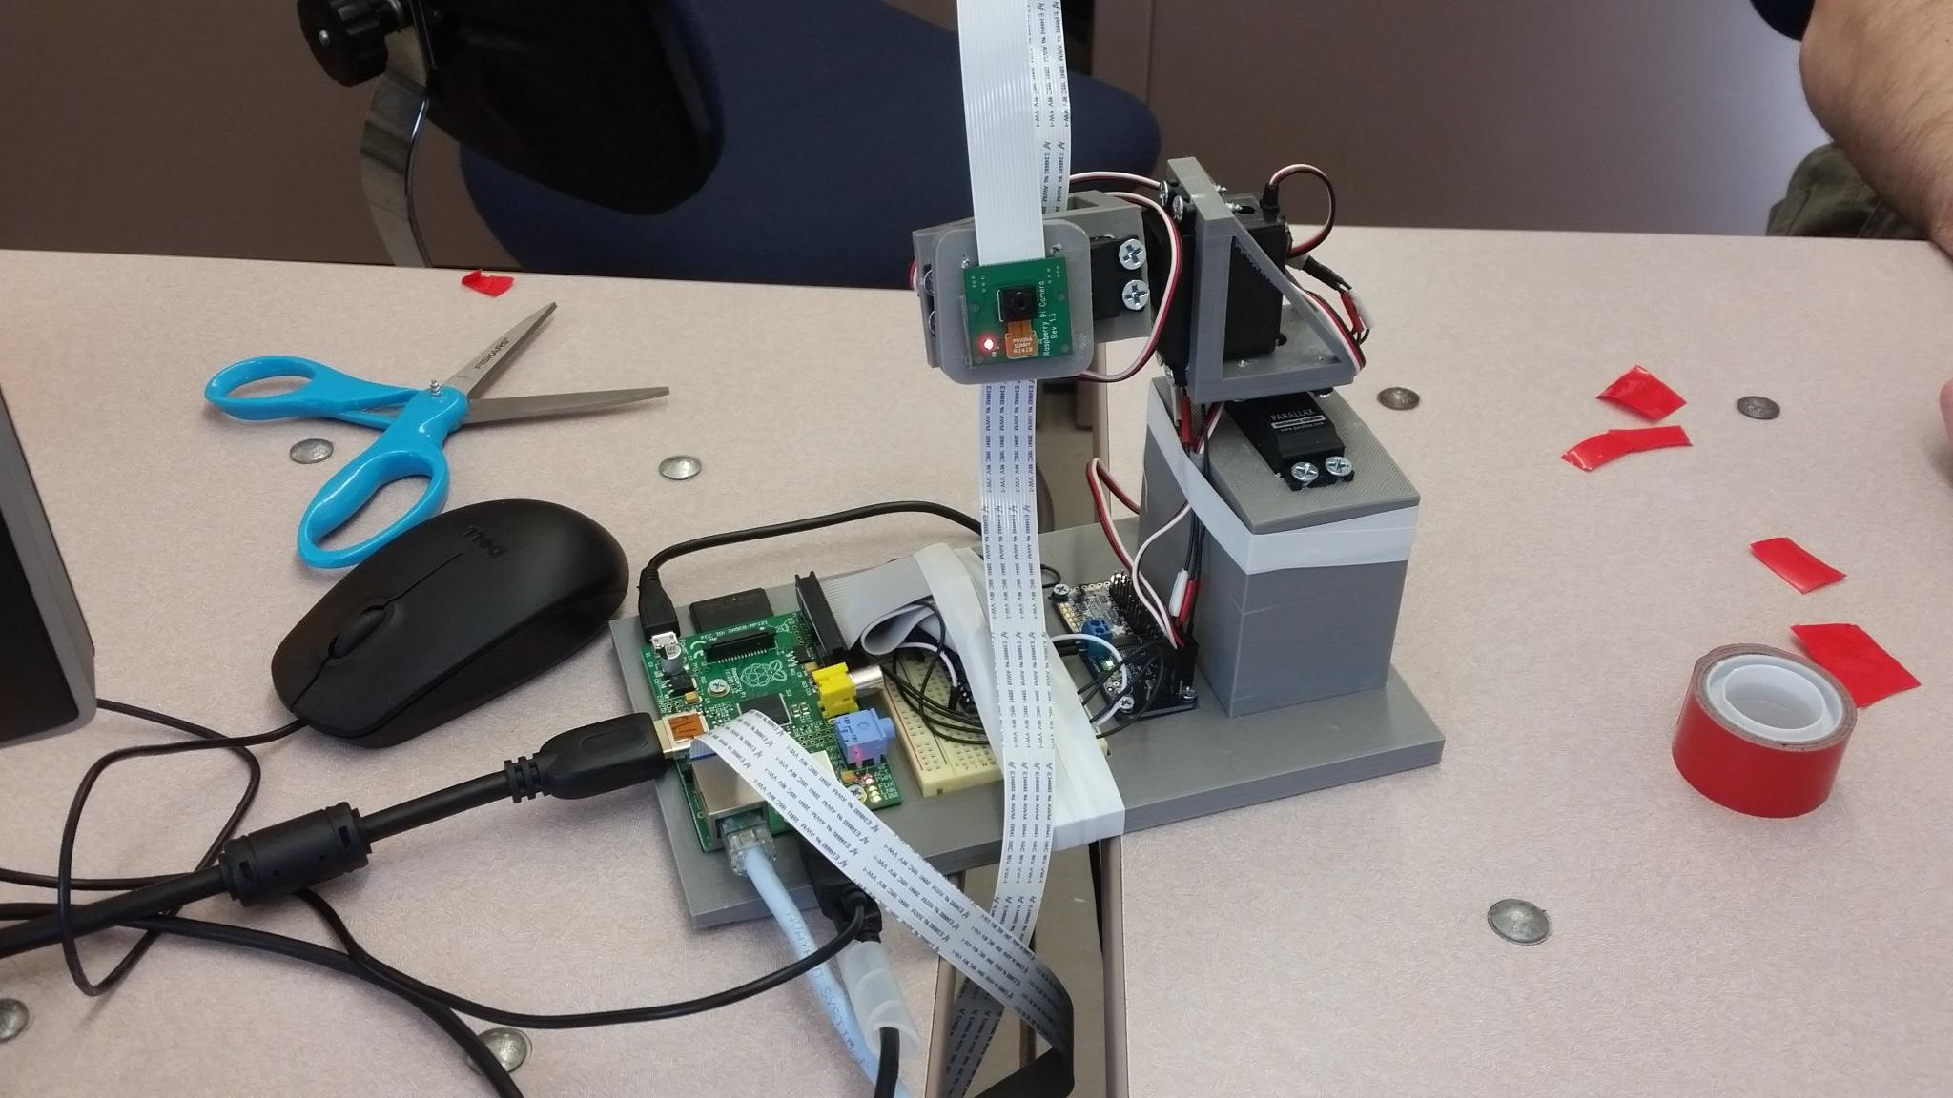
Completed Unit

Slide 12
Challenges
Getting the motion of the servos correct
web server permissions
resource allocations

Slide 13
DEMO TIME!

